Slide 1
Developing UX Metrics for Med Tech
How do you measure UX in healthcare?

Slide 2
Agenda
Introduction
UX Metrics in Big Tech
Applying UX Metrics to Medical Devices
Case Studies

Slide 3
HFES 2024 Workshop UX Metric Development
Heena Dani (Biofourmis)
Danny Nou (Abbott)
In an era marked by rapid technological advancements and an ever-evolving healthcare landscape, the need to prioritize user experience has never been more critical. This presentation delves into the pivotal role of user experience in healthcare innovation and highlights the transformation of human factors engineering from a safety-focused discipline into a driver of enhanced user experiences.

Slide 4
Big Tech vs. Med Tech
Historically, Silicon Valley is ahead of the med device industry in terms of UX.
An increasing amount of user expectations (touchscreens, apps, etc.) are driven by trends in Big Tech.
Good UX is critical to the success of consumer electronic devices. It isn’t always the product that has the most advanced tech that dominates the market.
Consumer products can iterate much more quickly than med devices.
Notes:
Danny had some material to evangelize HFE and need for UX considerations. Improving a product at lower cost when HF is involved in development.

Slide 5
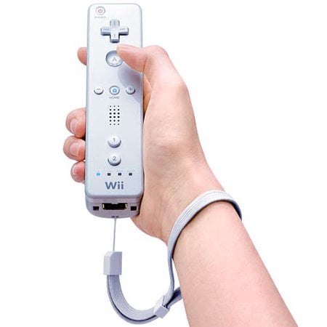
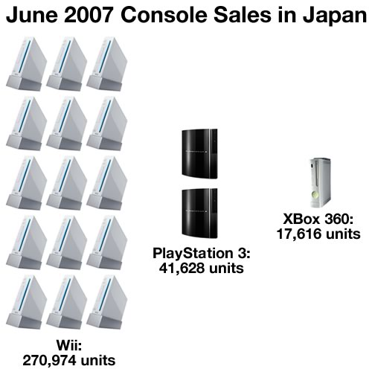
Wii vs. Xbox vs. PS3
Xbox 360 and PS3 had much more powerful hardware and better graphics (1080p) than the Wii (480p).
But the Wii controller and UX were more intuitive for a larger range of people!
Notes:
Other reasons like better pricing also contributed but usability was a huge part of the success.

Slide 6
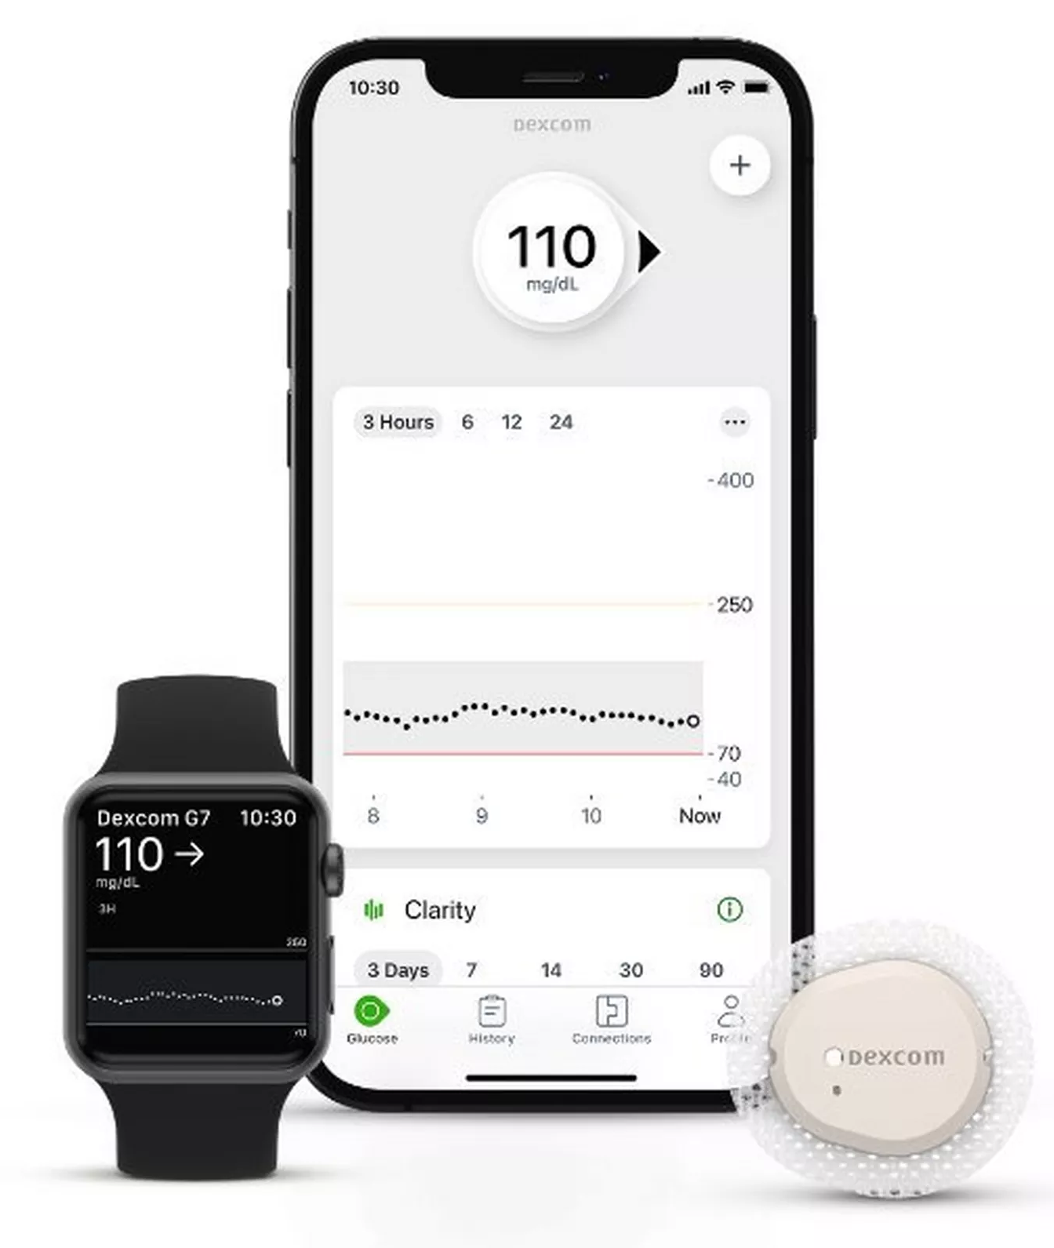
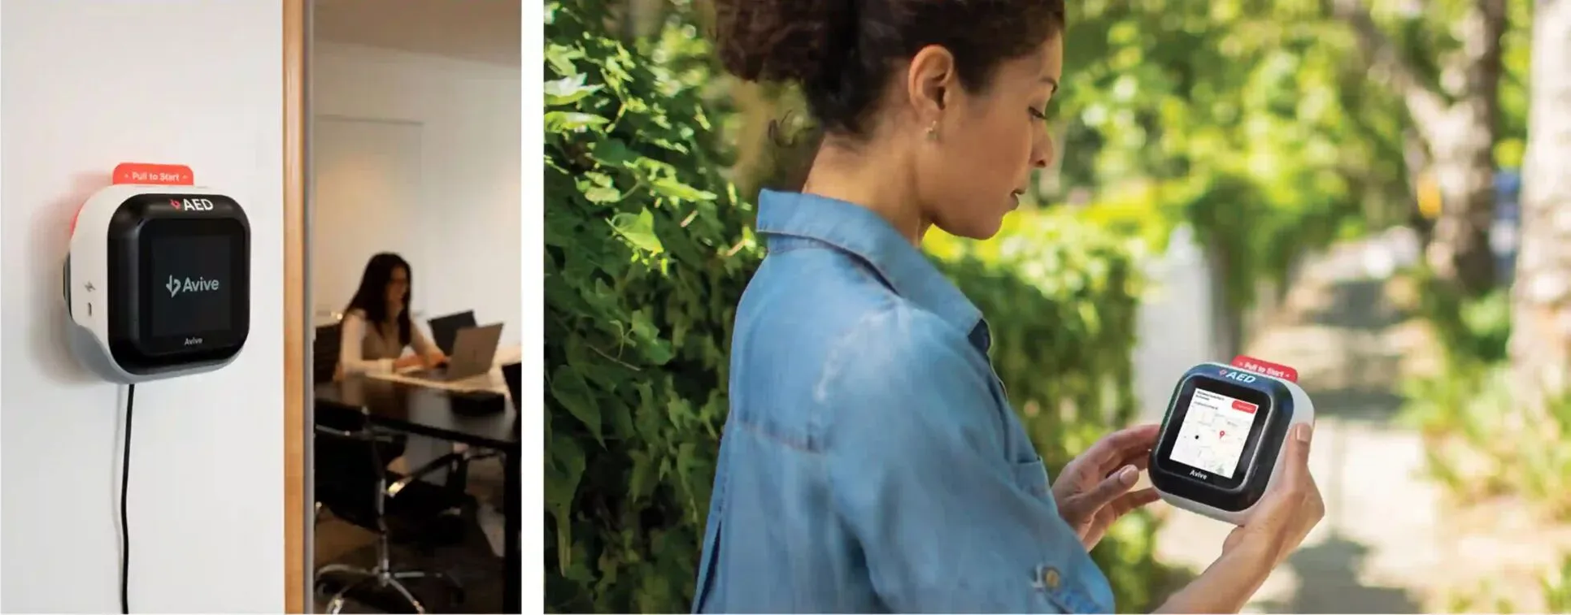
Closing the Gap
Tech companies are increasing their reach into the medical device space.
Apple Healthcare: FDA approves Apple Watch AFib History feature as a Medical Device Development Tool (MDDT) in May 2024.
Dexcom: Over-the-counter glucose monitor with smart device connectivity, approved by FDA in March 2024.
Avive AED: Ultra-portable smart AED that links 911 dispatch and AED owners to create a “4 Minute City” for SCA response. Initially an MIT capstone project, FDA approved in 2022.
Notes:
Barrier between Big Tech and med devices is thinning (Apple and Google have watches that are medical devices)…and we’ll be out competed if we don’t adapt…tech companies currently do UX a lot better than us.

Slide 7

Common Strategies Utilized in Big Tech
Notes:
Given all this, I want to look at some of the design strategies and metrics that have been refined and used at companies like Google, Meta, etc…we need to start borrowing their playbook.

Slide 8
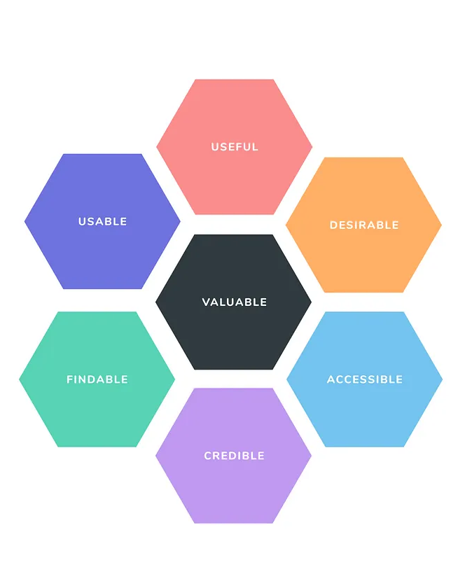
UX Honeycomb (Morville)
Useful: Does a product meet a key need of target users?
Usable: How well can a user use the product to accomplish a given purpose effectively, efficiently, and satisfactorily?
Desirable: Are we effectively leveraging emotional design to foster a relationship with the user?
Findable: Can a user find the function they’re looking for?
Accessible: Is it usable by people with a range of abilities/experience?
Credible: Does the user trust the company and the product?
Valuable: How well are each of the elements balanced for that customer? Can be interpreted as the sum of the other attributes.
Notes:
https://semanticstudios.com/user_experience_design/ WHO estimates 16% of people have a permanent disability of some sort…plus everyone who has a temporary one (broken wrist renders you singlehanded, eye infection limits vision).

Slide 9
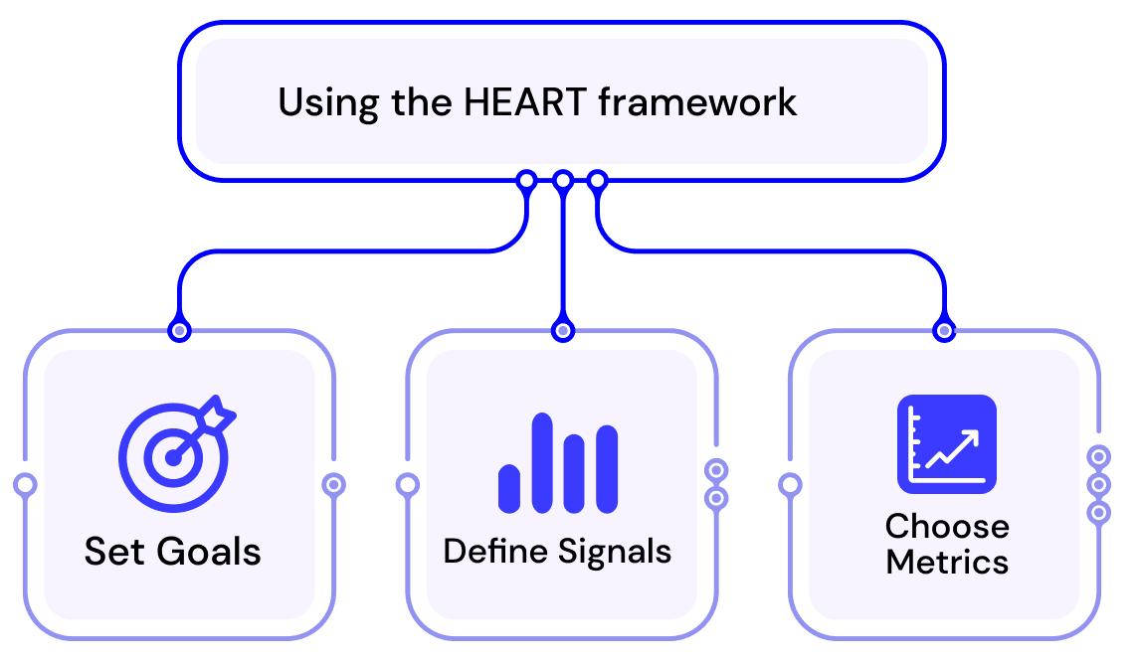
HEART Framework (Google)
Built on five metrics: Happiness, Engagement, Adoption, Retention, Task Success
Each of those is associated with:
Goals – Broad user objective.
Signals – What indicators can we observe to see if we’re progressing to the goal?
Metrics – Quantifiable data points indicating success or failure.
Notes:
The heart framework is a bit more adaptable for different products since you define the goals and their measurements.
https://www.heartframework.com/

Slide 10
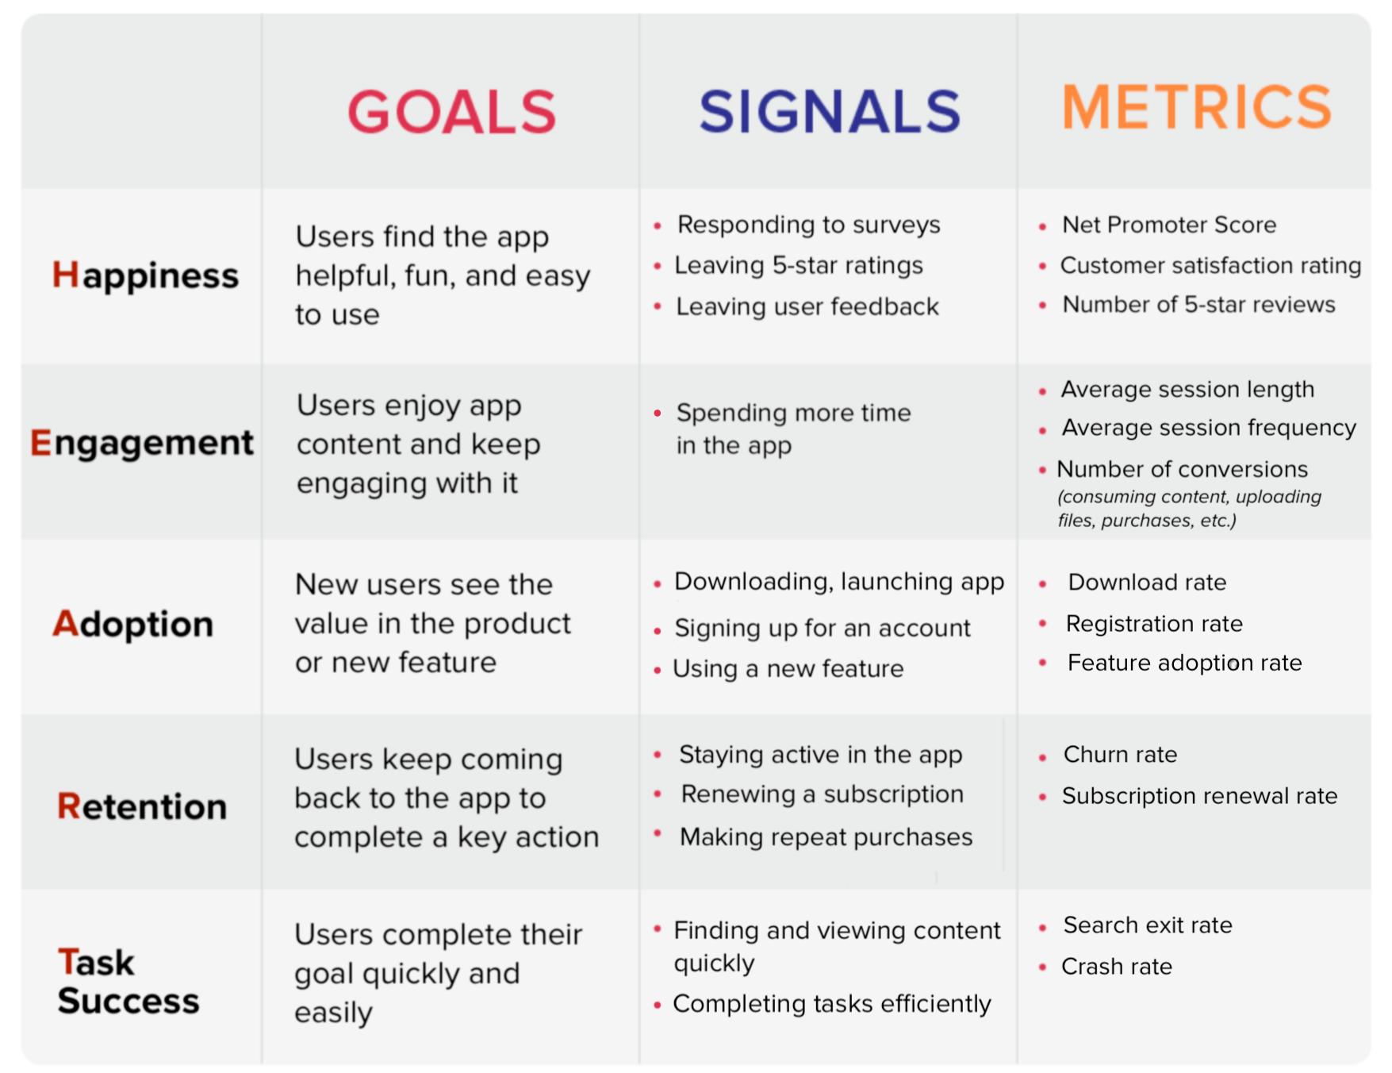
HEART Framework (Google)
Notes:
The heart framework is a bit more adaptable for different products since you define the goals and their measurements.
https://www.heartframework.com/

Slide 11
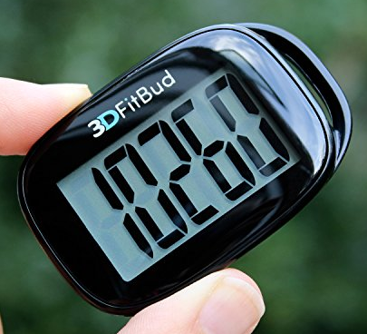
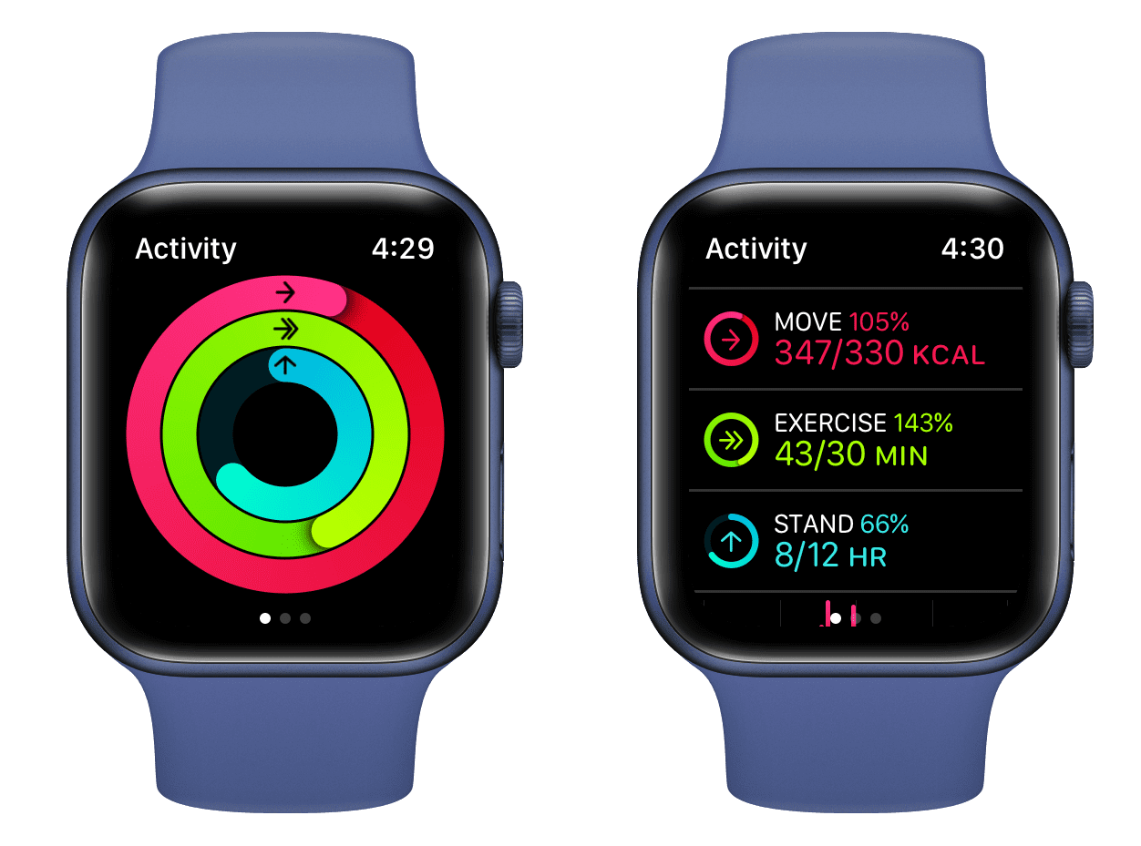
Gamification/Obfuscation
Improving compliance and user experience by altering the user relationship/perception to the product.
Apple Watch exercise rings deliberately use a data visualization model (donut chart) that the eye doesn’t process as accurately.
“You need 5,000 more steps” is a much more daunting figure than a half-filled ring.
The end user’s goal isn’t necessarily data-driven, they just want to see their status quickly.
Notes:
Ex: Loading bars without graduations or percentage numbers. We are much, much more accurate at guesstimating the value/percent of linear (esp. horizontal lines) due to human evolution. Prior to last few hundred years, very little perfect circle objects in our world.

Slide 12

UX Metrics for Med Devices
Notes:
How can we adopt some of these same ideas for our industry?

Slide 13
Why create our own metrics for UX?
Standardization: Ensures repeatability and applicability of an A/B assessment for future iterations.
Communication: Translating qualitative data into quantitative values (scores, percentages) that may be more easily understood at a cross-functional level.
Adaptability: Many UX measures/assessments are broad and generalized. These scoring systems may not account for needs specific to ZOLL and our users.
Any other reasons?
Notes:
Ex: Could standardize a score for the many internal handles concepts, allowing comparison between iterations. Like 5 pt scale for each prototype’s features…maneuverability, cleanability,

Slide 14
Metric Development Process (Dani & Nou)
Identify and prioritize critical factors
Translate critical factors into measurable parameters
Map user journey(s)
Study design
Might include stages with different users.
Notes:
Process at a high level. Each of these steps feed into the next.

Slide 15
Metric Development Process (Dani & Nou)
Identify and prioritize critical factors
Translate critical factors into measurable parameters
Map user journey(s)
Study design
Feedback Loop: Use dry runs/guerilla testing to tweak the metric scoring system.
Notes:
Process at a high level. Each of these steps feed into the next.

Slide 16
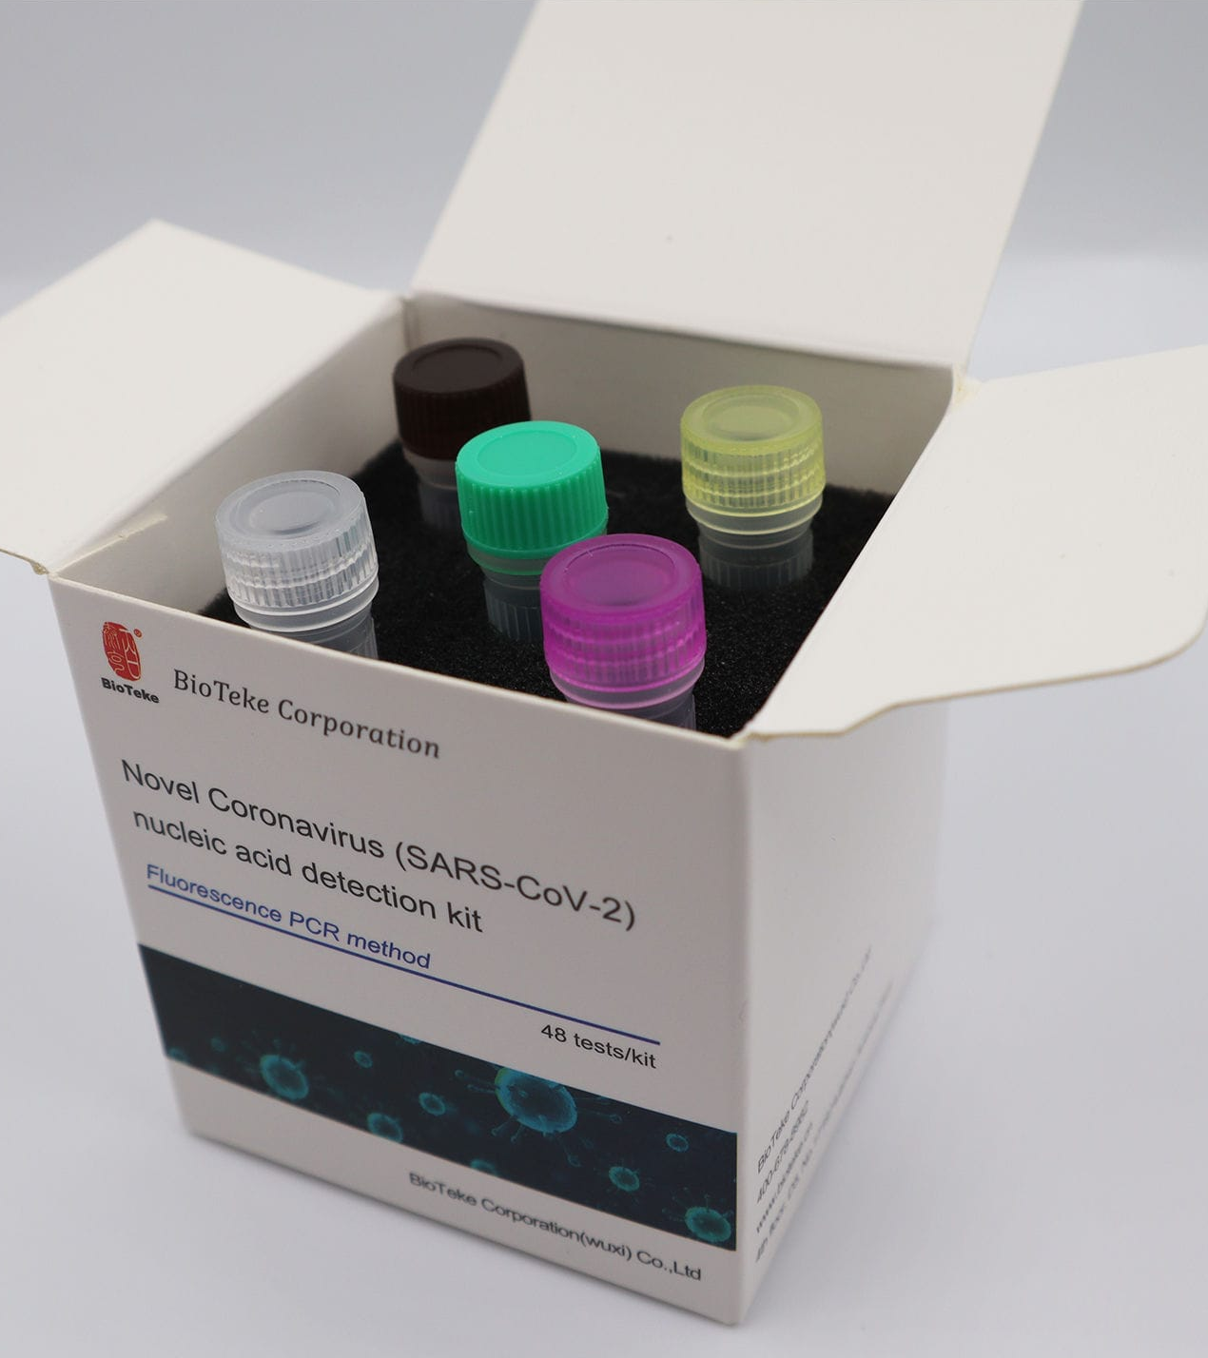
Case Study: PCR Test
A rapid diagnostic device in a professional setting.
Notes:
Going to go through journey map, ID’ing critical factors, and translating these into a metric.

Slide 17
1. User Journey
Purchasing
Buyer| Determines which test to purchase
Test Prep
Nurse/Lab Tech| Opens test kit, takes out materials, adds reagent.
Sample Collection
Nurse/Patient| Nurse collects sample. Patient has each nostril swabbed.
Sample Tested
Interpret Results
Nurse/Lab Tech| Process sample, adds it to test tube, and waits for it to develop.
Nurse/Lab Tech| Interprets result and communicates this to patient.
Notes:
Journey map with stages characterized by different users…The steps here map fairly directly to critical tasks but we need to synthesize the critical factors that are associated.

Slide 18
Critical Factors ≠ Critical Tasks
Critical (success) factors can be different at each stage, because each type of user has distinct priorities.
Ex: One lay user-identified critical factor may be “time to result”…whereas an HCP might prioritize “accuracy”.
Cost Benefit Analysis: Which area of focus/factor has the greatest impact?
Determine level of influence needed to change a feature, how much that feature matters to a user
Some critical factors aren't worth testing if there's no way to change it.

Slide 19
2a. Critical Factors
Purchasing
Cost, accuracy, access, ease of use, time to result
Test Prep
Ease of use, prep time
Sample Collection
Ease of use, time on task, emotional response (discomfort)
Sample Tested
Interpret Results
Ease of use, time to result
Ease of use, time on task
Notes:
Critical factors identified at each stage thru user interviews. Ease of use is a key thread in all of these!

Slide 20
2b. Prioritizing Critical Factors
Results from interviews and rank order surveys.
Final Rank | Critical Factor | Insights
1 | Accuracy | Provides confidence and trust in the result.
2 | Ease of use | A user-friendly test is easier to learn and is prone to less use-error.
3 or 4 | Time to result | Faster test = faster diagnosis (more critical in developed countries).
3 or 4 | Ability to test multiple patients at once | More throughput (more important in developing countries).
-- | Cost | Important to buyers only
-- | Digital result | Not critical on its own, considered within ease of use.
-- | EMR integration | Important to developing countries
Notes:
EMR integration since hard to keep track of results, may be difficult to get back in contact with patient after they leave. Patients may not know/have their medical history otherwise.

Slide 21
Not all critical factors are under our control!
Users valued time as a critical factor in several journey stages. We can’t necessarily control the science and time needed behind something…can’t make the reagent work any faster, etc.
But we can control:
Labeling: User perception of time by “chunking” steps. Frame the process as “a few 4-minute steps” rather than “20 minutes”.
Packaging: Increase learnability and efficiency by grouping/packaging certain elements together.
Notes:
Similar psychology for ads that say “only five payments of $19.99” rather than $100. Disney also does this in the theme parks by hiding elements that make a wait feel long, challenging the objectivity/perception…compare hidden lanes of a ride vs. the entirely visible maze of TSA checkpoints.

Slide 22
3a. What are aspects of the UX we can measure and improve?
 | Research Question | Measure
Learnability | When does a user go from novice to expert? | Determine test # at which user goes from novice to expert
Efficiency | How long does it take a novice vs. expert to perform multiple tests? | Determine time for novice user to test, compare that to an expert user
Usability | What are foreseeable errors, their occurrence, and severity? | Usability study, UFMEA
User satisfaction | How satisfied is a novice vs. expert when using this product | Survey for users
Notes:
Aspects may be unique to each product/project. Need to translate critical factors and their priorities into usability metrics. Like structure of HEART framework.

Slide 23
What are aspects of the UX we can measure and improve?
Assign point values to each attribute, based on the importance of each parameter.
Attribute | Min. Acceptable | Target | Max Value
Learnability | 10/12 | 10/12 | 10/12
Efficiency | 10/12 | 12/12 | 12/12
Usability | 7/8 | 8/8 | 8/8
User satisfaction | 6/8 | 8/8 | 8/8

Slide 24
3. Translate Critical Factors into a Scoring System
Scoring system needs to be adjusted:
Everyone rated satisfaction 6 or 7.
Signals too similar, some questions weren’t specific enough for satisfaction and efficiency.
Notes:
On the initial application of the scoring system, there is not a clear product that’s captured as highly preferred or disliked. Kinda opposite what you want in statistics. You can say that 1 and 2 were inferior to 3 and 4, but within those groups there’s not a ton of variability. There may not be enough/the correct sensitivity for these categories.

Slide 25
3. Translate Critical Factors into a Scoring System
May need to use study data to adjust the scoring system where needed based on sensitivity/signals, with signals being from users' rankings
Signal is present but not captured in current method --> reevaluate scoring/method
No signal is present, but scoring reflects presence --> reevaluate scoring/method
No signal is present, then all products are similar in this space --> is that parameter important?
Notes:
Signals being user behavior during assessment. Ex: Users all struggled with X but rated it highly for usability.

Slide 26
3. Translate Critical Factors into a Scoring System
Goal of adjustment to normalize data. One person’s “easy” isn’t the same as another’s.
Want data to be more polar, the results should capture a clear preference or dislike and why.

Slide 27
3. Translate Critical Factors into a Scoring System

Slide 28
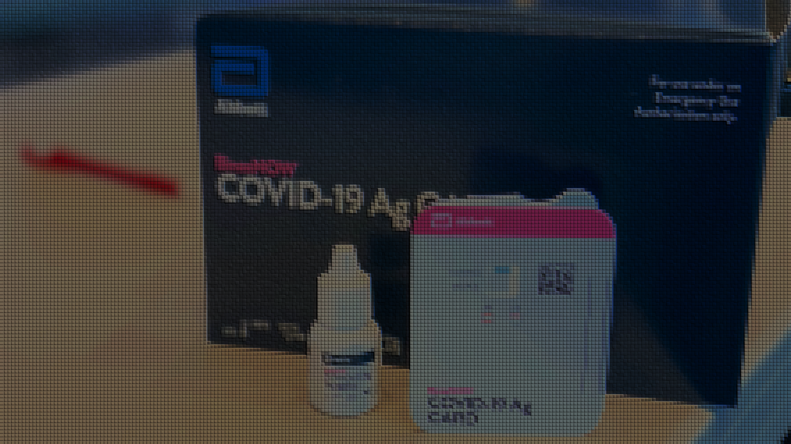
Case Study: Designing the Binax COVID test
Notes:
At this point, there was only professional lab testing options with the original longer nose swap (brain probe).

Slide 29
Company/Design Concerns
Area of Concern | Description
Lack of precedence | Most lay users have never had to use an at home test of any kind. Only comparable device is a pregnancy test.
Perceived safety | Concern that parents would be hesitant to use this on their children.
Durability | Kit needs to be shelf stable and survive transport as freight.
Cost | Needed to be something that could be manufactured at a huge scale.
Disposability/Biohazard concerns | Test kit needed to contain the sample for easy disposal.
Social distancing | Could not rely on HCPs to demonstrate or instruct a user to do the test. Challenge for recruitment.
Notes:
These were identified by the team but may not align with the user’s perceived challenges/problems.

Slide 30
Breaking down critical factors
The Abbott team utilized qualitative (interviews, ethnography) and quantitative (rank order tests, card sorts) activities.
Identifying Critical Factors: Initial interviews to understand context for users use environments, needs, etc.
Determining Critical Factor Priority: Now that we know what’s important to users…what’s most important?

Slide 31
User Concerns
Area of Concern | Description
Self-confidence | Will I be able to collect a good sample on my own?
Accuracy | Can I trust the results?
Time to result | How long do I have to wait?
Complex process | How many steps are there? Don’t want to go thru a 10+ step process every day/week.
Guidance/resources | What happens if I need help or have questions?
Notes:
Conducted interviews and surveys, less formal due to urgency and limitations during 2020. Guerilla testing and interviews with random passersby at pharmacies. Parents had no issue swabbing their kid.

Slide 32
Cassette vs. “lollipop” design

Slide 33
Thank you

